Slide 1
Video Game Market Analysis
MATEO MARIACA
SERGII LEBID
RATISH KUMAAR

Slide 2
Project Overview
The chosen dataset
Video Game Sales ( https://www.kaggle.com/datasets/gregorut/videogamesales )
Additional sources ( https://www.wikipedia.org )
The hypotheses
1) The sales of movie-based games are higher in the USA than in Japan
2) Regional variation in consumer preferences for the different games do to different strategies
3) Relevant differences in sales depending on the inspiration for a game.

Slide 3
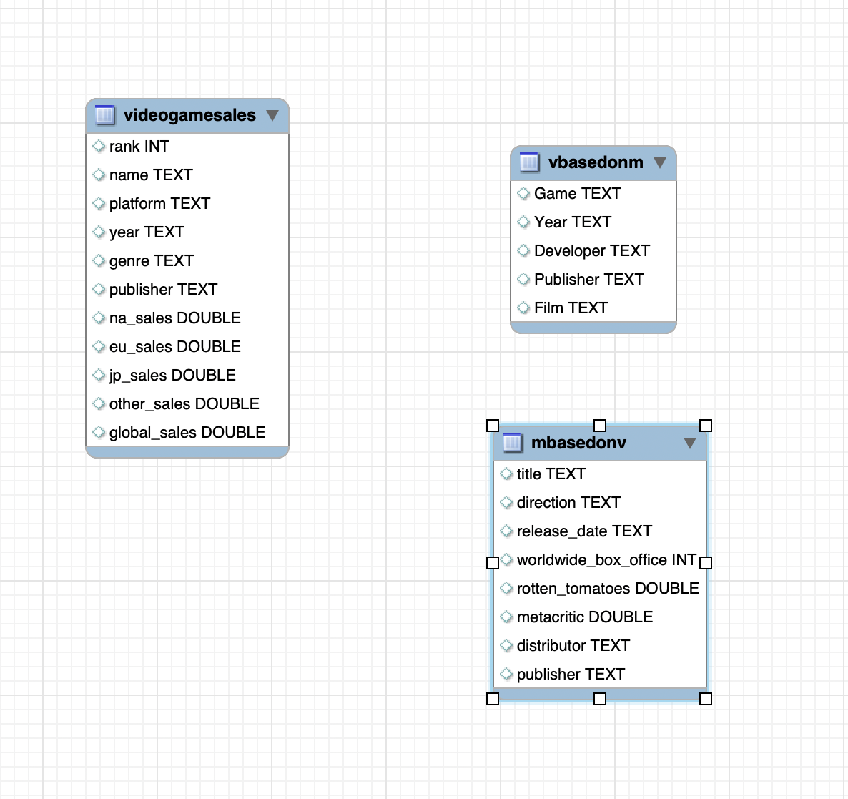

Slide 4
Data Acquisition, Enrichment, and Examination
Data Acquisition: Gathering relevant data from various sources.
1
Enrichment: Enhancing the collected data with additional information or context.
2
Examination: Analyzing and scrutinizing the enriched data to derive insights and draw conclusions
3

Slide 5
Database Design & Data Transformation
Video Games Based on Movies
Movies Based on Video Games
Video Games Sales
The key challenges faced during data transformation:
The necessity of using a non-standard delimiter when exporting from SQL to Tableau

Slide 6



SQL Insights & Advanced Analysis
Making data“ SQL-ready"

Slide 7
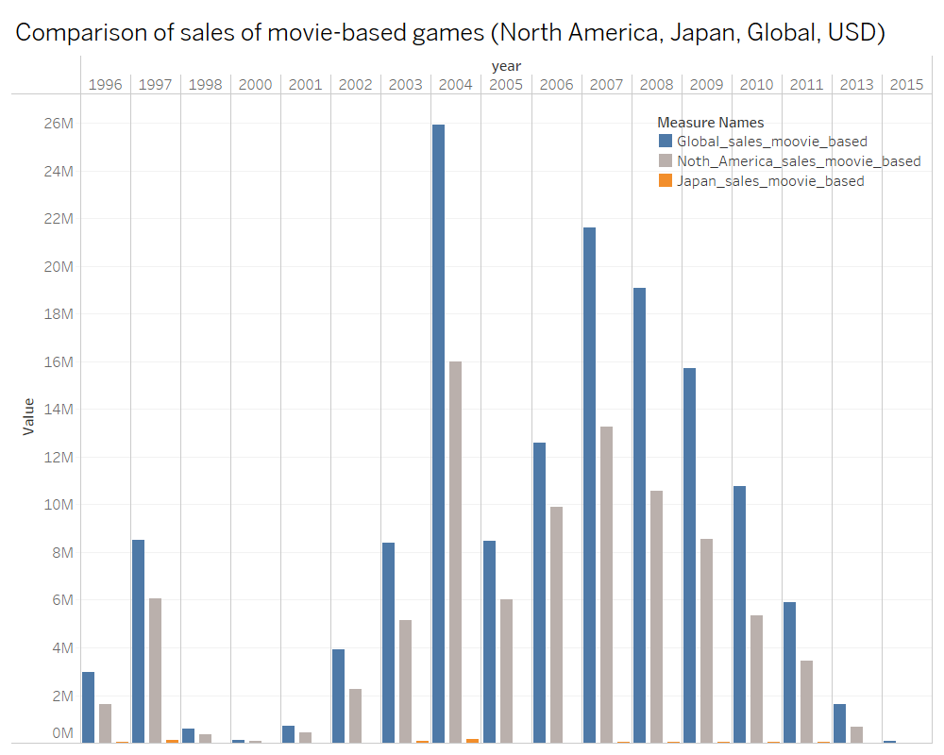
Visualization & Key Insights

Slide 8
Visualization & Key Insights
Sales comparison of North America Sales and Global sales with the data from Kaggle.
Top 10 games of sales between these countries excluded Japan and EU.

Slide 9
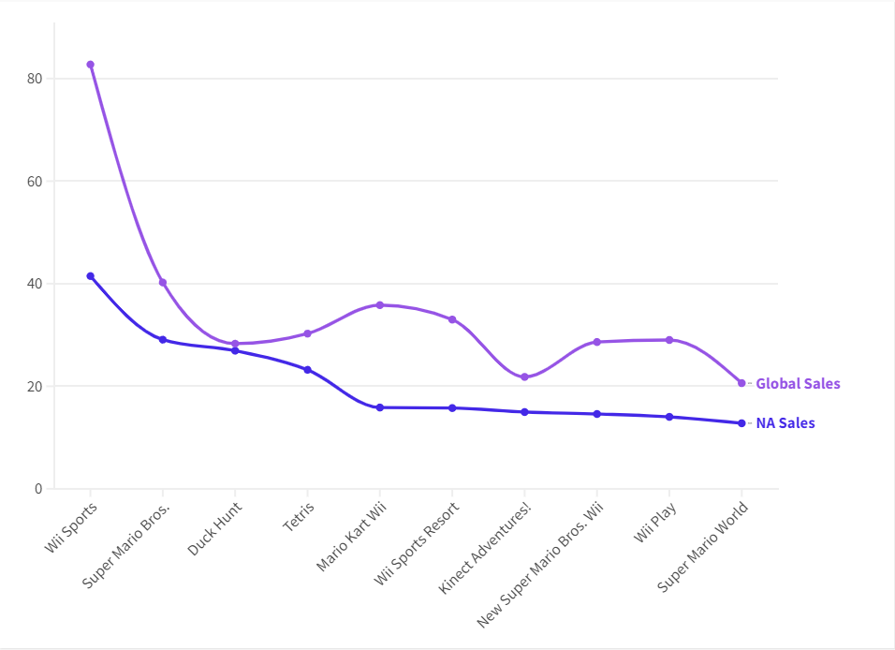

Slide 10
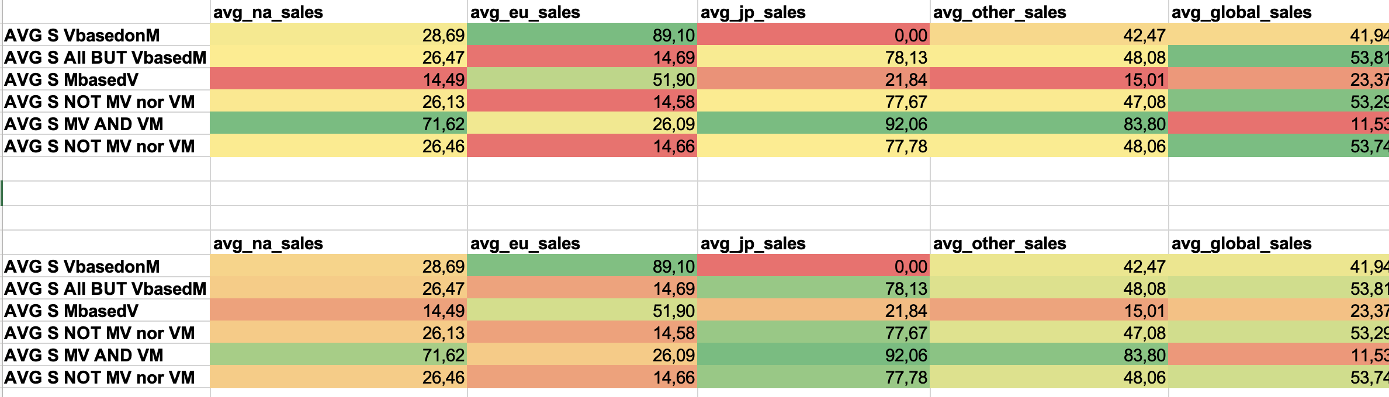
Visualization & Key Insights

Slide 11
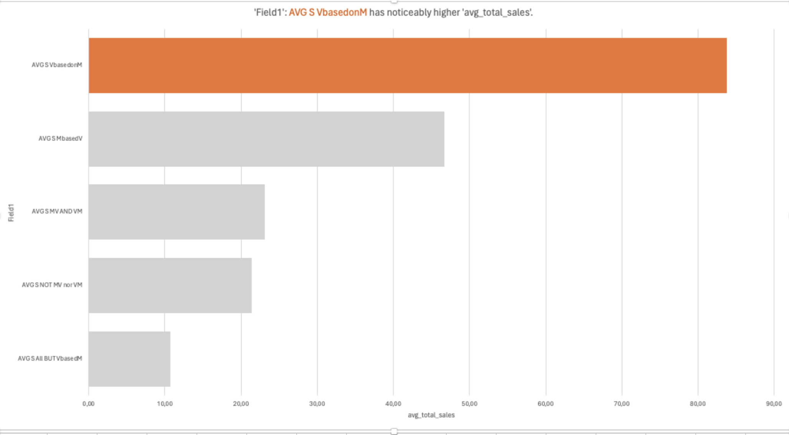
Visualization & Key Insights

Slide 12
Conclusions:
Yes NA has higher sales
Yes, the inspiration for a movie has repercutions on the sales

Slide 13

Thank you!

